Slide 1

The Development and Optimisation of a Convolutional Neural Network for Image Classification
Student: Fola Ogundero
Course : Msc Artificial Intelligence
Module: 20COP508:Machine Learning
Module Lead: Dr. Baihua Li

Slide 2
Abstract
In this project the capabilities of different neural network techniques including, multi-layered and single-layered
networks and the intricacies within their parameters and functionalities to further accuracy while preventing loss and generalisation are measured, while convergence is observed regarding standardisation via the use of confusion matrices.

Slide 3
Motivation
Weak linear separability found in single-layer networks leads to poor performance
Deeper networks are better suited to image classification tasks

Slide 4
Research questions
Can shallow neural networks effectively classify images ?
To what extent does hyperparameter optimisation effect the shallow network performance?

Slide 5
Dataset
This dataset contains 6,899 images from 8 distinct classes compiled from various source he classes include airplane, car, cat, dog, flower, fruit, motorbike and person.
Acknowledgements
Airplane images obtained from http://host.robots.ox.ac.uk/pascal/VOC
Car images obtained from https://ai.stanford.edu/~jkrause/cars/car_dataset.html
Cat images obtained from https://www.kaggle.com/c/dogs-vs-cats
Dog images obtained from https://www.kaggle.com/c/dogs-vs-cats
Flower images obtained from http://www.image-net.org
Fruit images obtained from https://www.kaggle.com/moltean/fruits
Motorbike images obtained from http://host.robots.ox.ac.uk/pascal/VOC
Person images obtained from http://www.briancbecker.com/blog/research/pubfig83-lfw-dataset

Slide 6
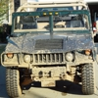

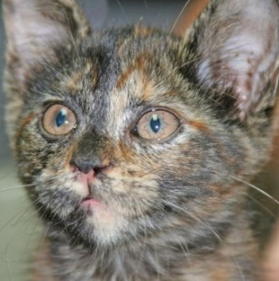
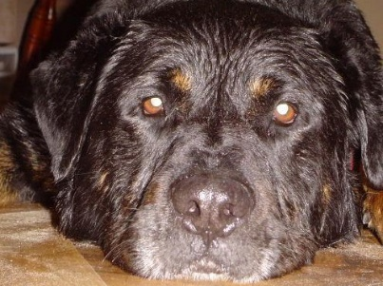

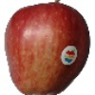

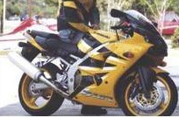
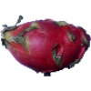

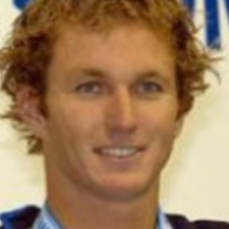
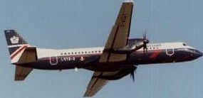
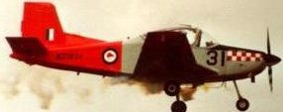
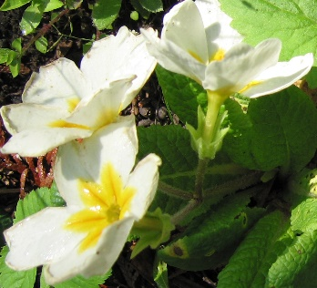

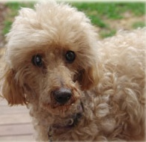
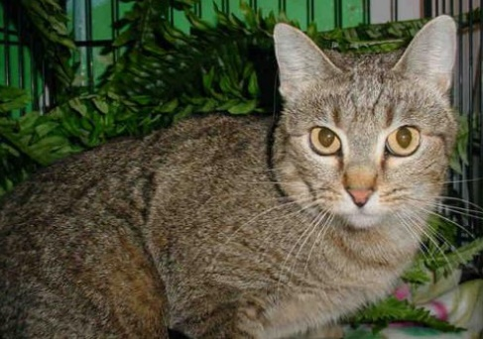
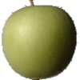
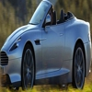
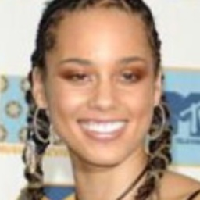
Dataset

Slide 7
Methodology
Python 3
Keras
Matplotlib
Images of 8 different types: airplane, car, cat, dog, flower, fruit, motorbike and person split across a training and test set ratio of 80/20
Input images changes to a resolution of 32 x 32 pixels with a batch size of 128
CNN architecture of 1 block of 2 convolutional layers
Each convolutional layer within the block used ReLU activation function
After each convolutional layer, Max pooling layers were used, resulting in 2 max pooling layers
Dropout rate of 0.25 was used twice, once after the convolutional layers and a second time after the initial fully connected dense layer
A softmax layer consisting of the number of classes so 8 neurons were implemented to classify and distinguish the images into their 8 respective categories: airplane, car, cat, dog, flower, fruit, motorbike and person
The Adam Optimiser was used for setting up the parameters
The loss function was set to the cross-entropy cost function
The model was trained for 20 epochs
The results were plotted with Matplotlib
A Wilcoxon signed-ranked test was carried out

Slide 8
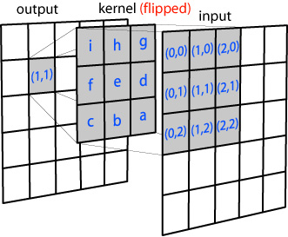
Convolution
Filters are initialized by Gaussian distribution, randomly. These filters are defined such that each filter learns about certain patterns, and these filters learn more patterns as the network gets deeper.

Slide 9
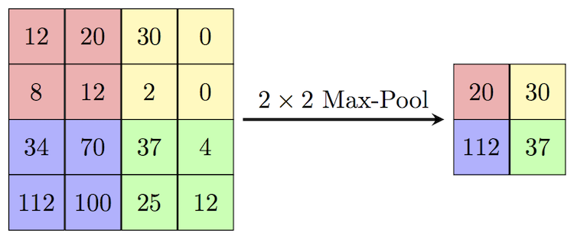
Pooling
The use of pooling is to reduce the dimension of the input image after getting convolved. There are two types, max pooling, and average pooling.

Slide 10
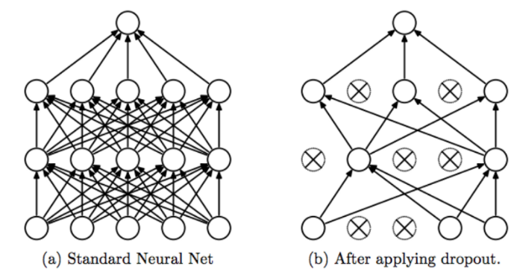
Dropout
Individual nodes are either dropped out of the net with probability 1-p or kept with probability p so that a reduced network is left;
A fully connected layer occupies most of the parameters, so neurons develop co-dependency amongst each other during training which leads to over-fitting of training data.

Slide 11
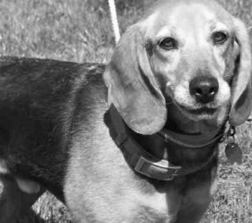
Digital representation of images
Images stored as greyscale matrix of pixels
Dimensions of this matrix are saved as images resolution of 32 x 32
Each pixel stores it brightness(or intensity) ranging from 0 to 255, 0 intensity corresponds to black colour
255
0

Slide 12
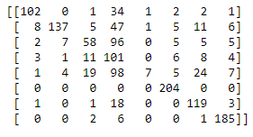

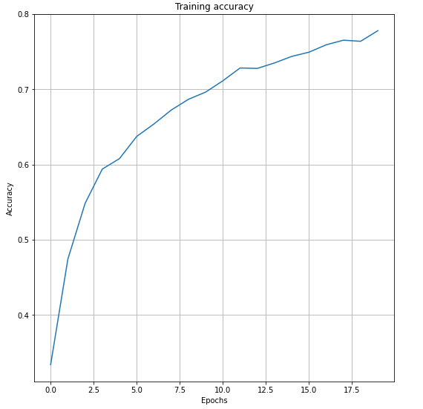
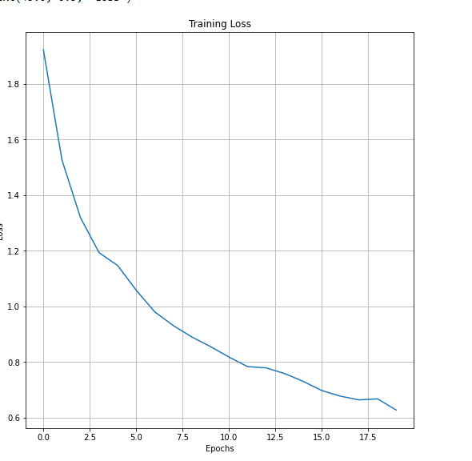
SGD
No Max Pooling
No Dropout
Initial Performance

Slide 13
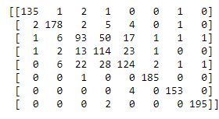

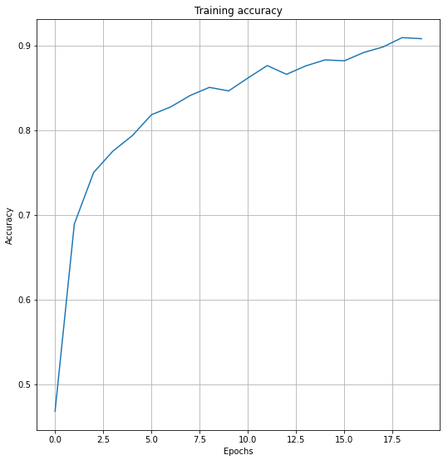
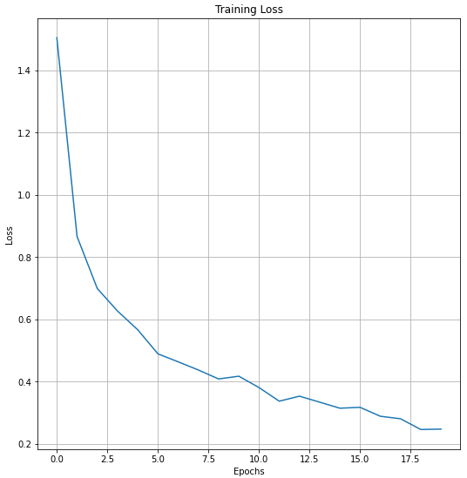
Adam Optimiser
Max Pooling
Dropout
Cat now being identified as a cat more than dog
Optimisations

Slide 14
Comparison
Architecture | Test Loss | Test Accuracy
Initial | 1.039 | 0.66
Optimised | 0.384 | 0.852

Slide 15
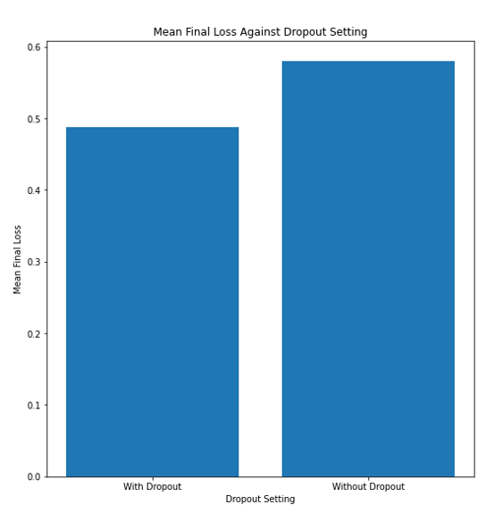
Wilcoxon Signed-Rank Test
Proves that there is a greater than 99% chance that the results were better with dropout than without due them having a less than 0.1% chance that the results from the experiments share the same distribution.

Slide 16
Future work
Implementing Batch normalisation - Normalise all the features by normalising the output of a previous activation layer by subtracting the batch mean and dividing by the batch standard deviation helping to learn more effectively and prevent overfitting
Implementing Zero Padding – Padding the input volume with zeros around the border to prevent dimensionality loss during convolution
Implementing a more convoluted network model such as VGG16 – Shown to have high accuracy for image recognition in ImageNet by using 5 blocks of 14 convolutional layers - multiple 3 x 3 kernel sized filters one after the other

Slide 17
Future Applications
Personal photos organization
Autonomous cars
Autonomous drones
Solving captcha / OCR
Filtering pictures for a picture based website/app
Automatically tagging pictures for an app
Extraction information from videos (tv show, movies)
Visual question answering
Art

Slide 18
Conclusion
This study’s results provide further evidence of the efficacy of convolutional neural networks the classification of commonplace, real-world objects in images. The architecture may be further optimised through the fine-tuning of hyperparameters such as network topology, optimiser function, or the application of dropout to minimise overfitting. Further work may be done to explore methods from existing literature, which may be applied to this project in the further improvement of everyday performance as well as, skip connections to avoid problems such as the vanishing gradient problem.

